Slide 1



Capgemini
CONSULTING. TECHNOLOGY. 0 UT SOURCING
People
matter.
results
count.
Fresher Learning Program
Teradata Training – BTEQ
Hyderabad, Date, Sreedevi.Ipparthy

Slide 2

Module
Object
➢ Introduction about Teradata
➢ Introduction to BTEQ.
➢ Use of BTEQ
➢ Transaction Mode in BTEQ
➢ Conditional Logic in BTEQ
➢ BTEQ Return Codes
➢ Using BTEQ to Export Data
➢ Using BTEQ to Import Data
➢ BTEQ Commands
Utility.
Presentation Title | Date
Copyright © Capgemini 2015. All Rights Reserved 2

Slide 3
Introduction about Teradata Utility
What is the need of Teradata utilities in Data ware house
➢
Quick access to data for more timely decision making.
➢
Solutions for the entire spectrum of load requirements from batch to near real time.
➢
Unmatched scalability for large volume loads.
➢
Fail-proof loads with checkpoint restart capabilities.
➢
Proven technology from the data warehouse technology leader.
➢
Integration with industry-leading ETL and ELT tools.
Teradata Utilities
BTEQ: Help for Report formatting, Ad hoc query tool, Database administration, Best for small data volumes.
Fast Export :High-performance data unload in client format.
Fast Load: High-performance initial table load.
Multi Load: High-performance maintenance operations applies updates to multiple tables in single pass.
Apart from these teradata having other utilities like Teradata Parallel
Transporter,Tpump e.t.c.
Presentation Title | Date
Copyright © Capgemini 2015. All Rights Reserved 3

Slide 4
Introduction to BTEQ
The core and main utility of Teradata is BTEQ , which stands for Batch/Basic Teradata
Query. This is a command –based utility submitting SQL requests to the Teradata database.
Characteristics:
➢
➢
➢
➢
➢
➢
BTEQ (Basic Teradata Query) operates in either a Batch or Interactive mode.
BTEQ runs on every supported platform.
BTEQ has the ability for Exporting data from database and importing data to database.
BTEQ has flexible and easy-to-use report writer.
Reads input data and imports it to the Teradata database as INSERTs, UPDATEs or DELETEs.
Exports data to a client system from the Teradata database:
As displayable characters suitable for reports, or
In native host format, suitable for other applications. BTEQ does error reporting.
➢
Presentation Title | Date
Copyright © Capgemini 2015. All Rights Reserved 4

Slide 5
Supporting Environment
The Fast Export utility is supported either on either the mainframe
attached system(LAN)
The LAN environment supports the following Operating Systems:
➢UNIX MP-RAS
➢Windows 2000
➢Windows 95
➢Windows NT
➢UNIX HP-UX
➢AIX
➢Solaris SPARC
➢Solaris Intel
or
on
network
The Mainframe (Channel Attached) environment
Systems:
➢MVS
➢VM
supports the following
Operating
CAUTION: The Teradata RDBMS will only support a maximum of 15 simultaneous
FastLoad, MultiLoad, or FastExport utility jobs
Presentation Title | Date
Copyright © Capgemini 2015. All Rights Reserved 5

Slide 6
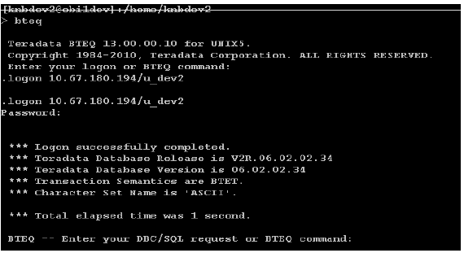
Use of Bteq
Bteq can be used either batch or interactive environment.
❖ Interactive Mode:
Interactive users can submit SQL and receive an answer set on the screen.
Steps to follow:
➢Use the word bteq.
➢Logon by giving the host id/user id.
➢Give the correct password for this user.
➢After connect
the session
use the required
query
to get
the result.
Presentation Title | Date
Copyright © Capgemini 2015. All Rights Reserved 6

Slide 7
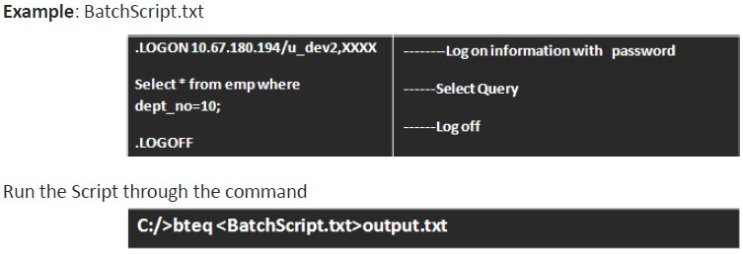
Use of Bteq
Batch Mode:
Users can submit BTEQ jobs from batch scripts, have error checking and conditional logic, and allow
for the work to be done in the background.
To submit a job in Batch mode do
➢Invoke BTEQ
➢Type in the input file name
➢Type in the location and output file name.
the
following:
Presentation Title | Date
Copyright © Capgemini 2015. All Rights Reserved 7

Slide 8
Transaction Mode
Teradata works in two modes:
❖ Teradata Mode
❖ ANSI Mode
While using BTEQ, it is possible to over-ride the transaction
mode at the session
level. Since the session is established at logon time, it is necessary to set the
mode prior to issuing a logon connection request. In BTEQ, either of the
following
commands can be used to change to ANSI
or Teradata
(BT-ET)
mode:
.SET SESSION TRANSACTION BTET;
Or
.SET SESSION TRANSACTION ANSI;
Presentation Title | Date
Copyright © Capgemini 2015. All Rights Reserved 8

Slide 9
Transaction Mode
BT-ET Mode:
Use a BT-ET statement
to Begin Transaction
(BT) and
End Transaction
(ET). Like
BT;
// SQL statements;
//SQL statements;
ET;
When multiple statements are placed into a single transaction in Teradata Mode (BT-ET
mode) an error with any statement causes all of the SQL statements to ROLLBACK and then all locks are released and it is committed automatically if the entire transaction is successful. This means all the SQL statement placed in the BT-ET block are treated as a single statement.
It is also called the explicit transaction mode. When multiple statements are included in
BT-ET mode, you can only specify a DDL statement if it is the last statement.
Presentation Title | Date
Copyright © Capgemini 2015. All Rights Reserved 9

Slide 10
Transaction Mode
❖ Multi-Statement Request:
Another way to achieve the Teradata mode is Multi-Statement Request. Multi-statement request is
created in BTEQ by placing ending semi-colons as the first character of next SQL statement and makes the statement list
as one transaction. Here is an example of a BTEQ transaction in Teradata Mode that is considered one transaction:
UPDATE Employee_Table
SET Salary = Salary * 1.1
SET Dept_Name = ‘Sales’
WHERE Dept_No = 10;
In multi-statement request, if a transaction has any SQL fail then all SQL statements are rolled back
and locks are released. DDL statements are not valid in an implicit multi-statement transaction.
Presentation Title | Date
Copyright © Capgemini 2015. All Rights Reserved 10

Slide 11
Transaction Mode
❖ ANSI Mode:
In ANSI mode, just the opposite is true. All SQL commands
the same logical transaction. A transaction is not complete executed. Therefore, each of the DML commands in ANSI
are considered to be part of
until an explicit
mode needs to
COMMIT is
perform the
release the
following command to permanently store the data, and more importantly,
write locks that are currently held:
COMMIT WORK;
As an example, to remove all rows,
both statements below can be needed in ANSI mode.
DELETE FROM TEST_TABLE;
COMMIT WORK;
Without a COMMIT WORK, it is likely that the DELETE will abort and all the rows will be
put back.
Presentation Title | Date
Copyright © Capgemini 2015. All Rights Reserved 11

Slide 12

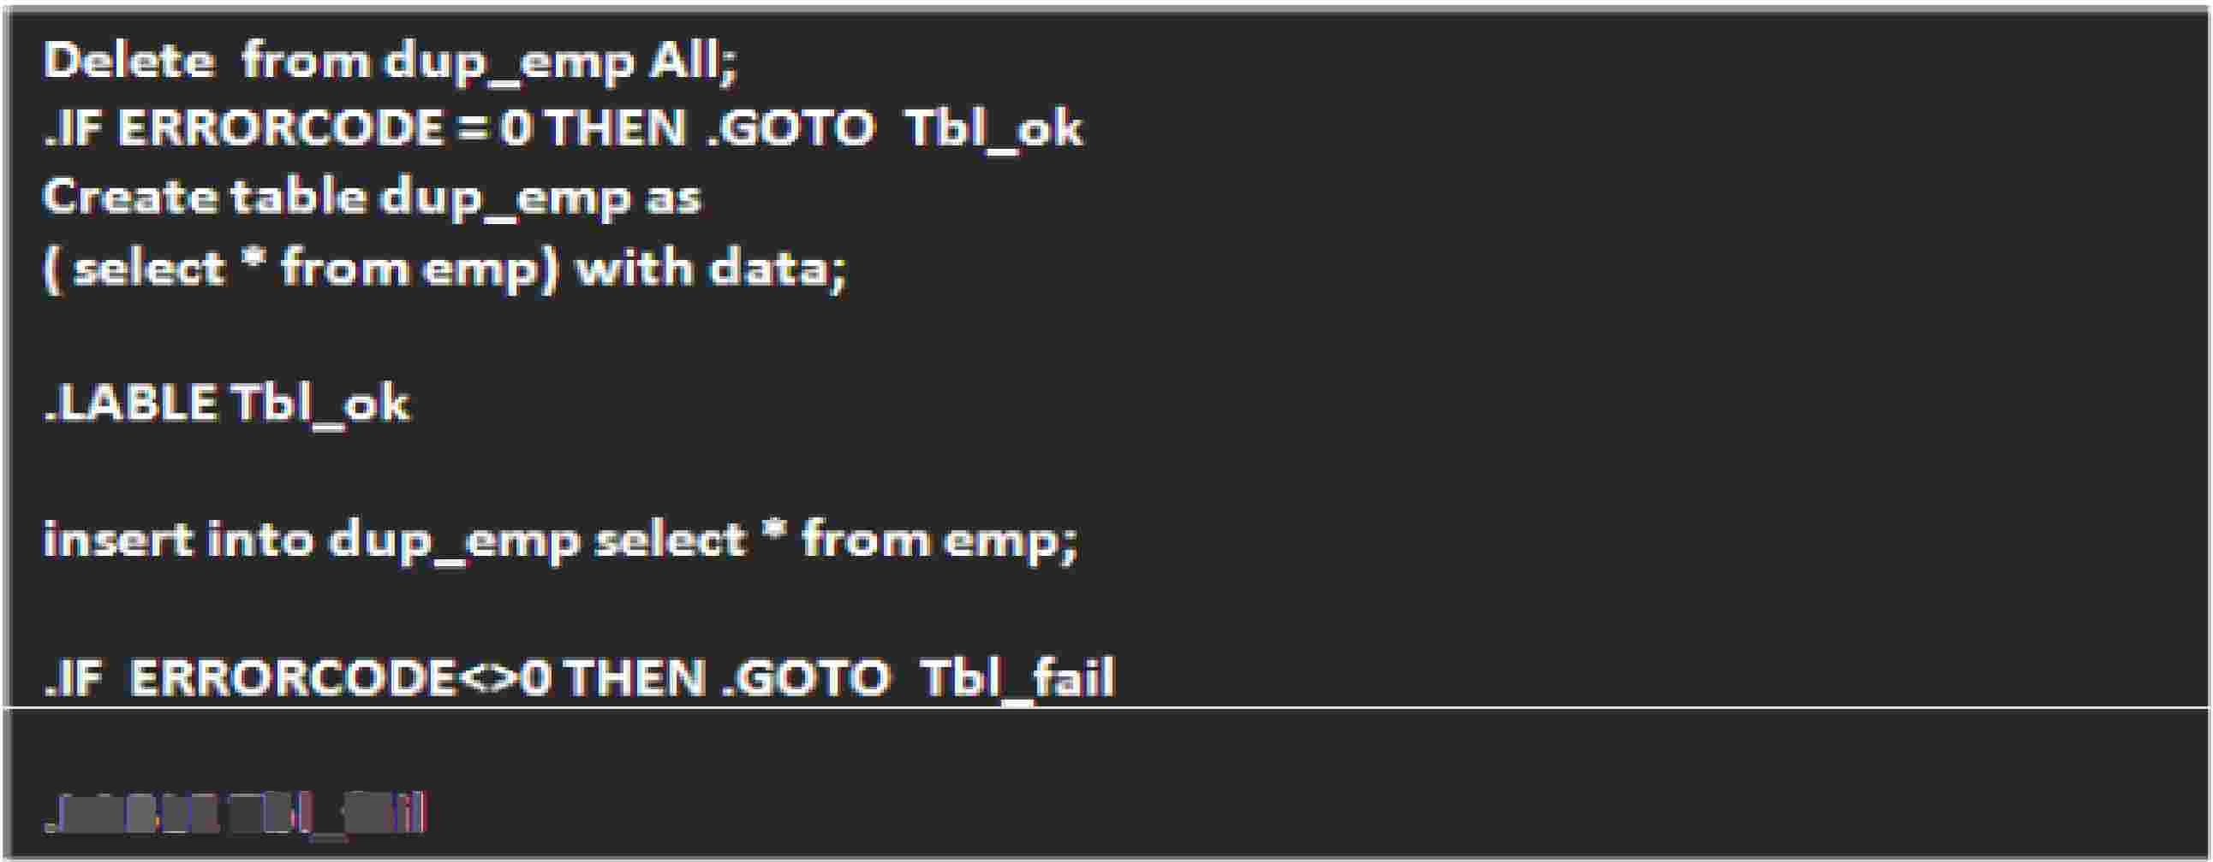

Conditional
Logic
in
BTEQ
Create
a duplicate table
same as ernp table:
1-LABLE Tbl_fail
Delete the records from the duplicate table dup_emp,
if it has,
If the result is non zero then create the duplicate table, else attempt to insert the records from
parent table emp.
If getting non zero result in insert activity then go to the next instruction,
Capgemmi
CON 5 ULT I NG. TECH NOL O G Y. 0 UT 5 0 UR CI NG
Presentation Title | Date
Copyright © Capgemini 2015. All Rights Reserved 12

Slide 13
BTEQ Return Codes
Bteq Returns two-digit values to the user after completing each job or task
The value of the return code indicates the completion status of the job or task as follows.
Return Code Description
➢00 Job completed with no errors.
➢02 User alert to log on to the Teradata DBS.
➢04 Warning error.
➢08 User error.
➢12 Severe internal error.
You can over-ride the standard error codes at the time you terminate BTEQ. This might
be handy for debug purposes. The error code or "return code" can be any number you specify using one of the following
Override Code Description
.QUIT 15
.EXIT 15
Presentation Title | Date
Copyright © Capgemini 2015. All Rights Reserved 13

Slide 14

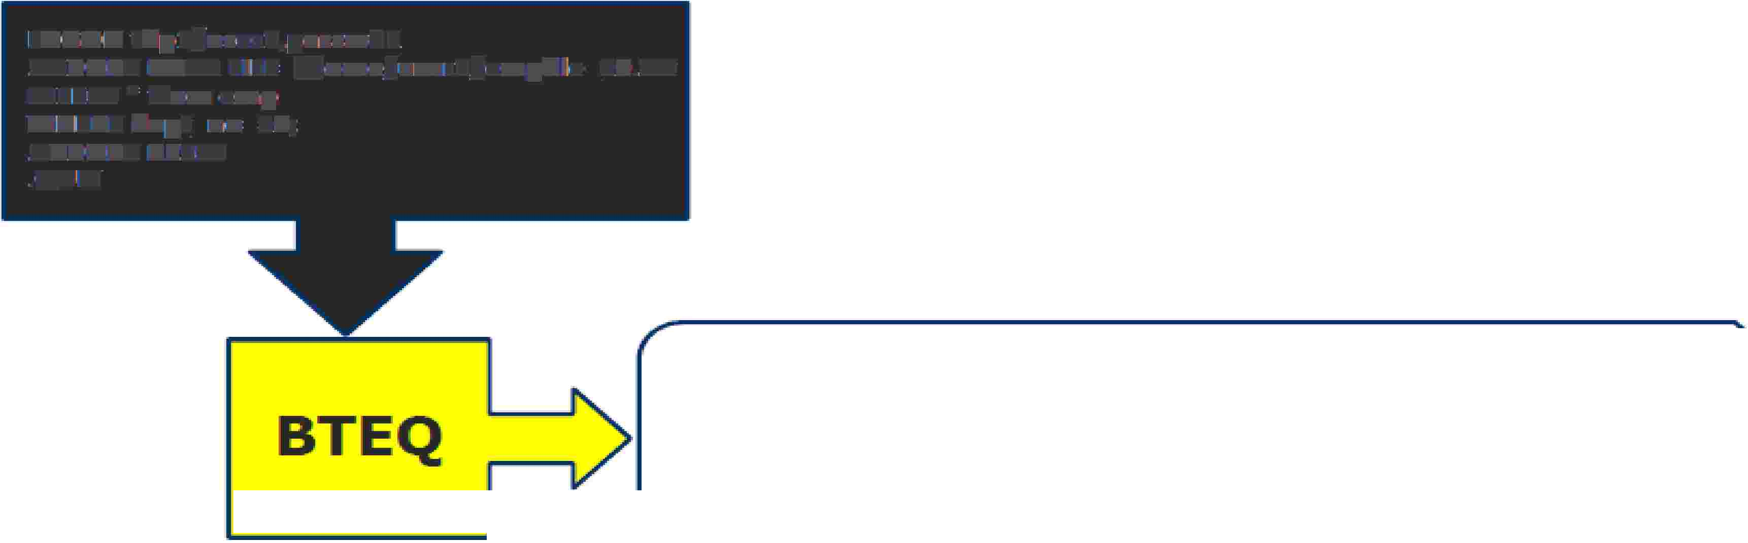




Using BTEQ to Export Data
IBTEQ alHows. data tu be exported directlv from Teradata tu a fHe on a mainframe or network-attached computer,
with desired output.
Generallv , user exported data in with different export format, composed of vari1ety of characteristics,
F'onm1at of Export command :
.. EXPORT <mode> {FIILE [I DDNAME} =<filename>[, UMIT=n
Exa1mpllle :
Bteq script: exportl.btq
LOGON tdp1/us-er1,passwd1
.EXIPORT DATA flLE=/home/user1/empfile_10.txt
SElE¹CT * from ernp
WHERE dept_no=:10;
.EXIPORT RIESET
.QlllT
7782,,ClARK.,MANAGER,, 7839 .. 19¹81-06-09,245'0.0Qi.,? ,10
7839, Kl NG"' PRES I DlE N"t?, 1981-·1·1-17, 5¹000.00,?, 10
BTEQ
7'9.34.,M I LLER.,CLE RK"' 7782,
.,1982-01-2,3·"' 1300 .. iOO"'? .,·10
bte q < expo rtl .. btq>empfille_lO ..itxt
O utp1ut: e mpfi I e_·10 .. tx:t
Capgemmi
CON 5 ULT I NG. TECH NOL O G Y. 0 UT 5 0 UR CI NG
Presentation Title | Date
Copyright © Capgemini 2015. All Rights Reserved 14

Slide 15



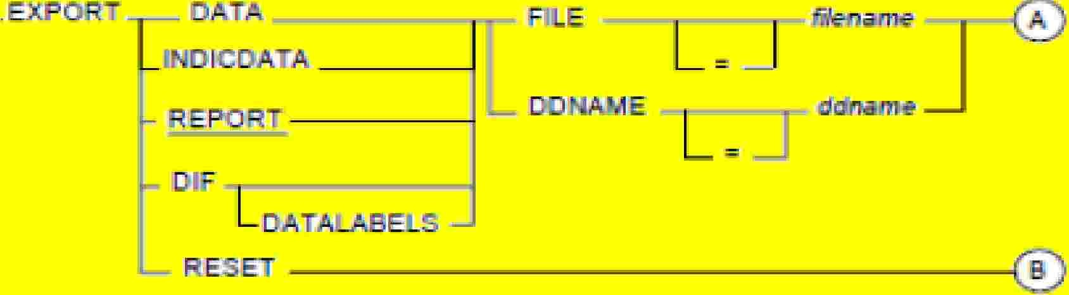

Using
BTEQ
to
Export
Data
Record Mode (also called DATA mode): This is
set by. EXPORT DATA. This w111II bring data back. as a flat file. there
are no headers or white space between the data contained in each column and the data ls written to the file in
native format, not understood using text editor,
Field Mode (ialso called REPORT mode): This is set lby .EXPORT REPORT This is the default mode for BTEQ and
brings the data back as if it was a standard SQL SELECT statement, output of this
column headers for the fields, and better understood m text editor.
BTEQ export would return the
Capgemmi
CON 5 ULT I NG. TECH NOL O G Y. 0 UT 5 0 UR CI NG
Presentation Title | Date
Copyright © Capgemini 2015. All Rights Reserved 15

Slide 16
Using BTEQ to Export Data
Indicator Mode:
This is set by .EXPORT INDICDATA. This mode writes the data in data mode, but also provides host operating systems with the means of recognizing missing or unknown data (NULL) fields. This is important if the data is to be loaded into another Relational Database System (RDBMS).
DIF Mode:
Known as Data Interchange Format, which allows users to export
be directly utilized for spreadsheet applications like Excel, FoxPro and Lotus.
data
from
Teradata
to
In Mainframe export the data into the file by define command
.EXPORT DATA DDNAME = data definition state name (JCL)
like:
In LAN export the data into the file by define command like :
.EXPORT DATA FILE = actual file name
Presentation Title | Date
Copyright © Capgemini 2015. All Rights Reserved 16

Slide 17

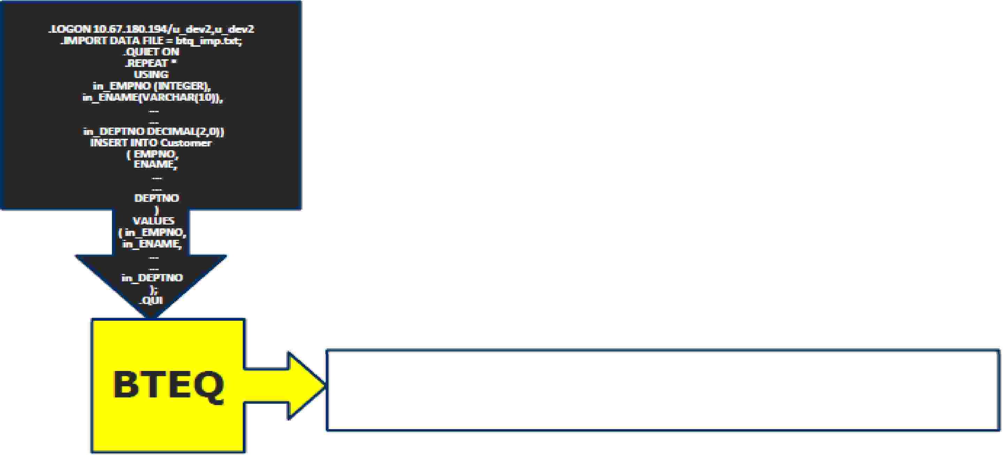





Using BTEQ to Import Data
BTEQ can also read a file from the hard disk and incorporate the data into SQl to modify the contents of one 01r
moire tables. In order to do this processing, the name
and
record description of the file must be
known ahead
of
time. These wrn be defined within the script file.
f'onmat of the MPORT command:
.IMPORT {
FILE I
DNA.ME}= <fHename>[,SIKIP=n]
BTEQ
77:a:2 OLARK MA.NAG ER 7839
1.'981.--06-41)9
1.9181. -1.1-1. 7
2450.00
5000.00
1.3@0.00
? 1.(l1
? 10
? 10
7839 KING
P'RESID ENT ?
7964 Ml LILER ct.ERK
7782 1.982-4jll1- '.B
Capgemmi
CON 5 ULT I NG. TECH NOL O G Y. 0 UT 5 0 UR CI NG
Presentation Title | Date
Copyright © Capgemini 2015. All Rights Reserved 17

Slide 18
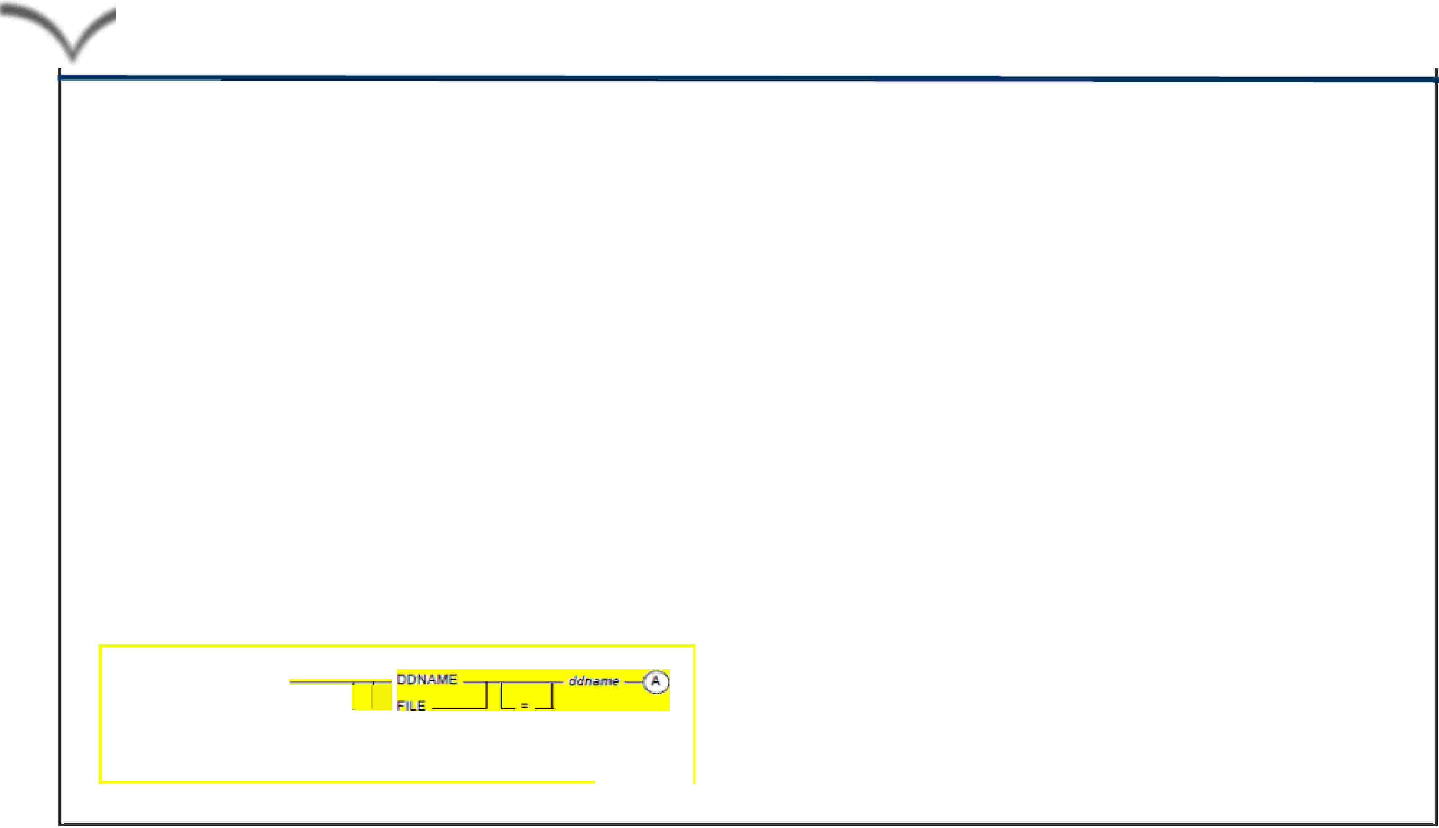
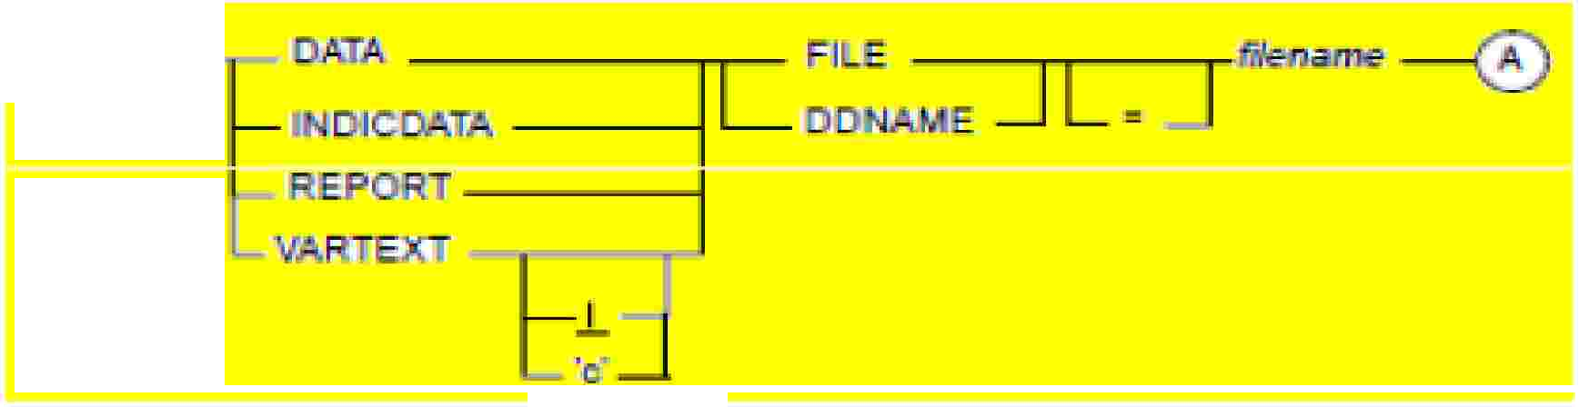




Using BTEQ to Import Data
BTEQ can also read a fi le from the ha rd d isk and incorporate the data mto SQ . to modify the contents of one
or more tables, In order to do this processing, the name and
of tune, These will be defined withln the script fillle.
record
description
of the file must be
known
ahead
flormat of the MP'ORT command:
.IMPORT { FILE I D A.ME}= <filename>(,SIKIP=n]
For Network-Attac ed Systems.:
For Channel-Attached .Sys.terns:
.IM
I
TI
IL
I
A. )'-------.----------.------------1...I
Capgemmi
CON 5 ULT I NG. TECH NOL O G Y. 0 UT 5 0 UR CI NG
Presentation Title | Date
Copyright © Capgemini 2015. All Rights Reserved 18

Slide 19
Using BTEQ to Import Data
DATA
Imports data from the server to Teradata
with a USING clause.
INDICDATA
Import records contain NULL bits.
REPORT
Imports Teradata “report”data. Data expected in BTEQ EXPORT
REPORT format.
VARTEXT
Record format as
is | or specify with
variable length character fields. Default delimiter
field delimiter within single quotes.
Presentation Title | Date
Copyright © Capgemini 2015. All Rights Reserved 19

Slide 20

BTEQ Commands
The BTEQ commands i1n Teradata are designed for flexibllltv These commands are not used direcUy on the data
inside the tables. However, these 60 ditferent HTEQ commands are utilized in four areas.
)io'"Session Control Commands:
begin and end BTEQ sessions, and control session characteristics.
�File Control Commands:
Spedfy input and output formats and identify information sources and destinations,
)io'"Sequence Control Commands:
control the sequence in which other BTEQ commands and Teradata SQL statements willll lbe executed within scripts and ma cros.
�Format Control Commands:
control the format of screen a nd printer output.
Capgemmi
CON 5 ULT I NG. TECH NOL O G Y. 0 UT 5 0 UR CI NG
Presentation Title | Date
Copyright © Capgemini 2015. All Rights Reserved 20

Slide 21

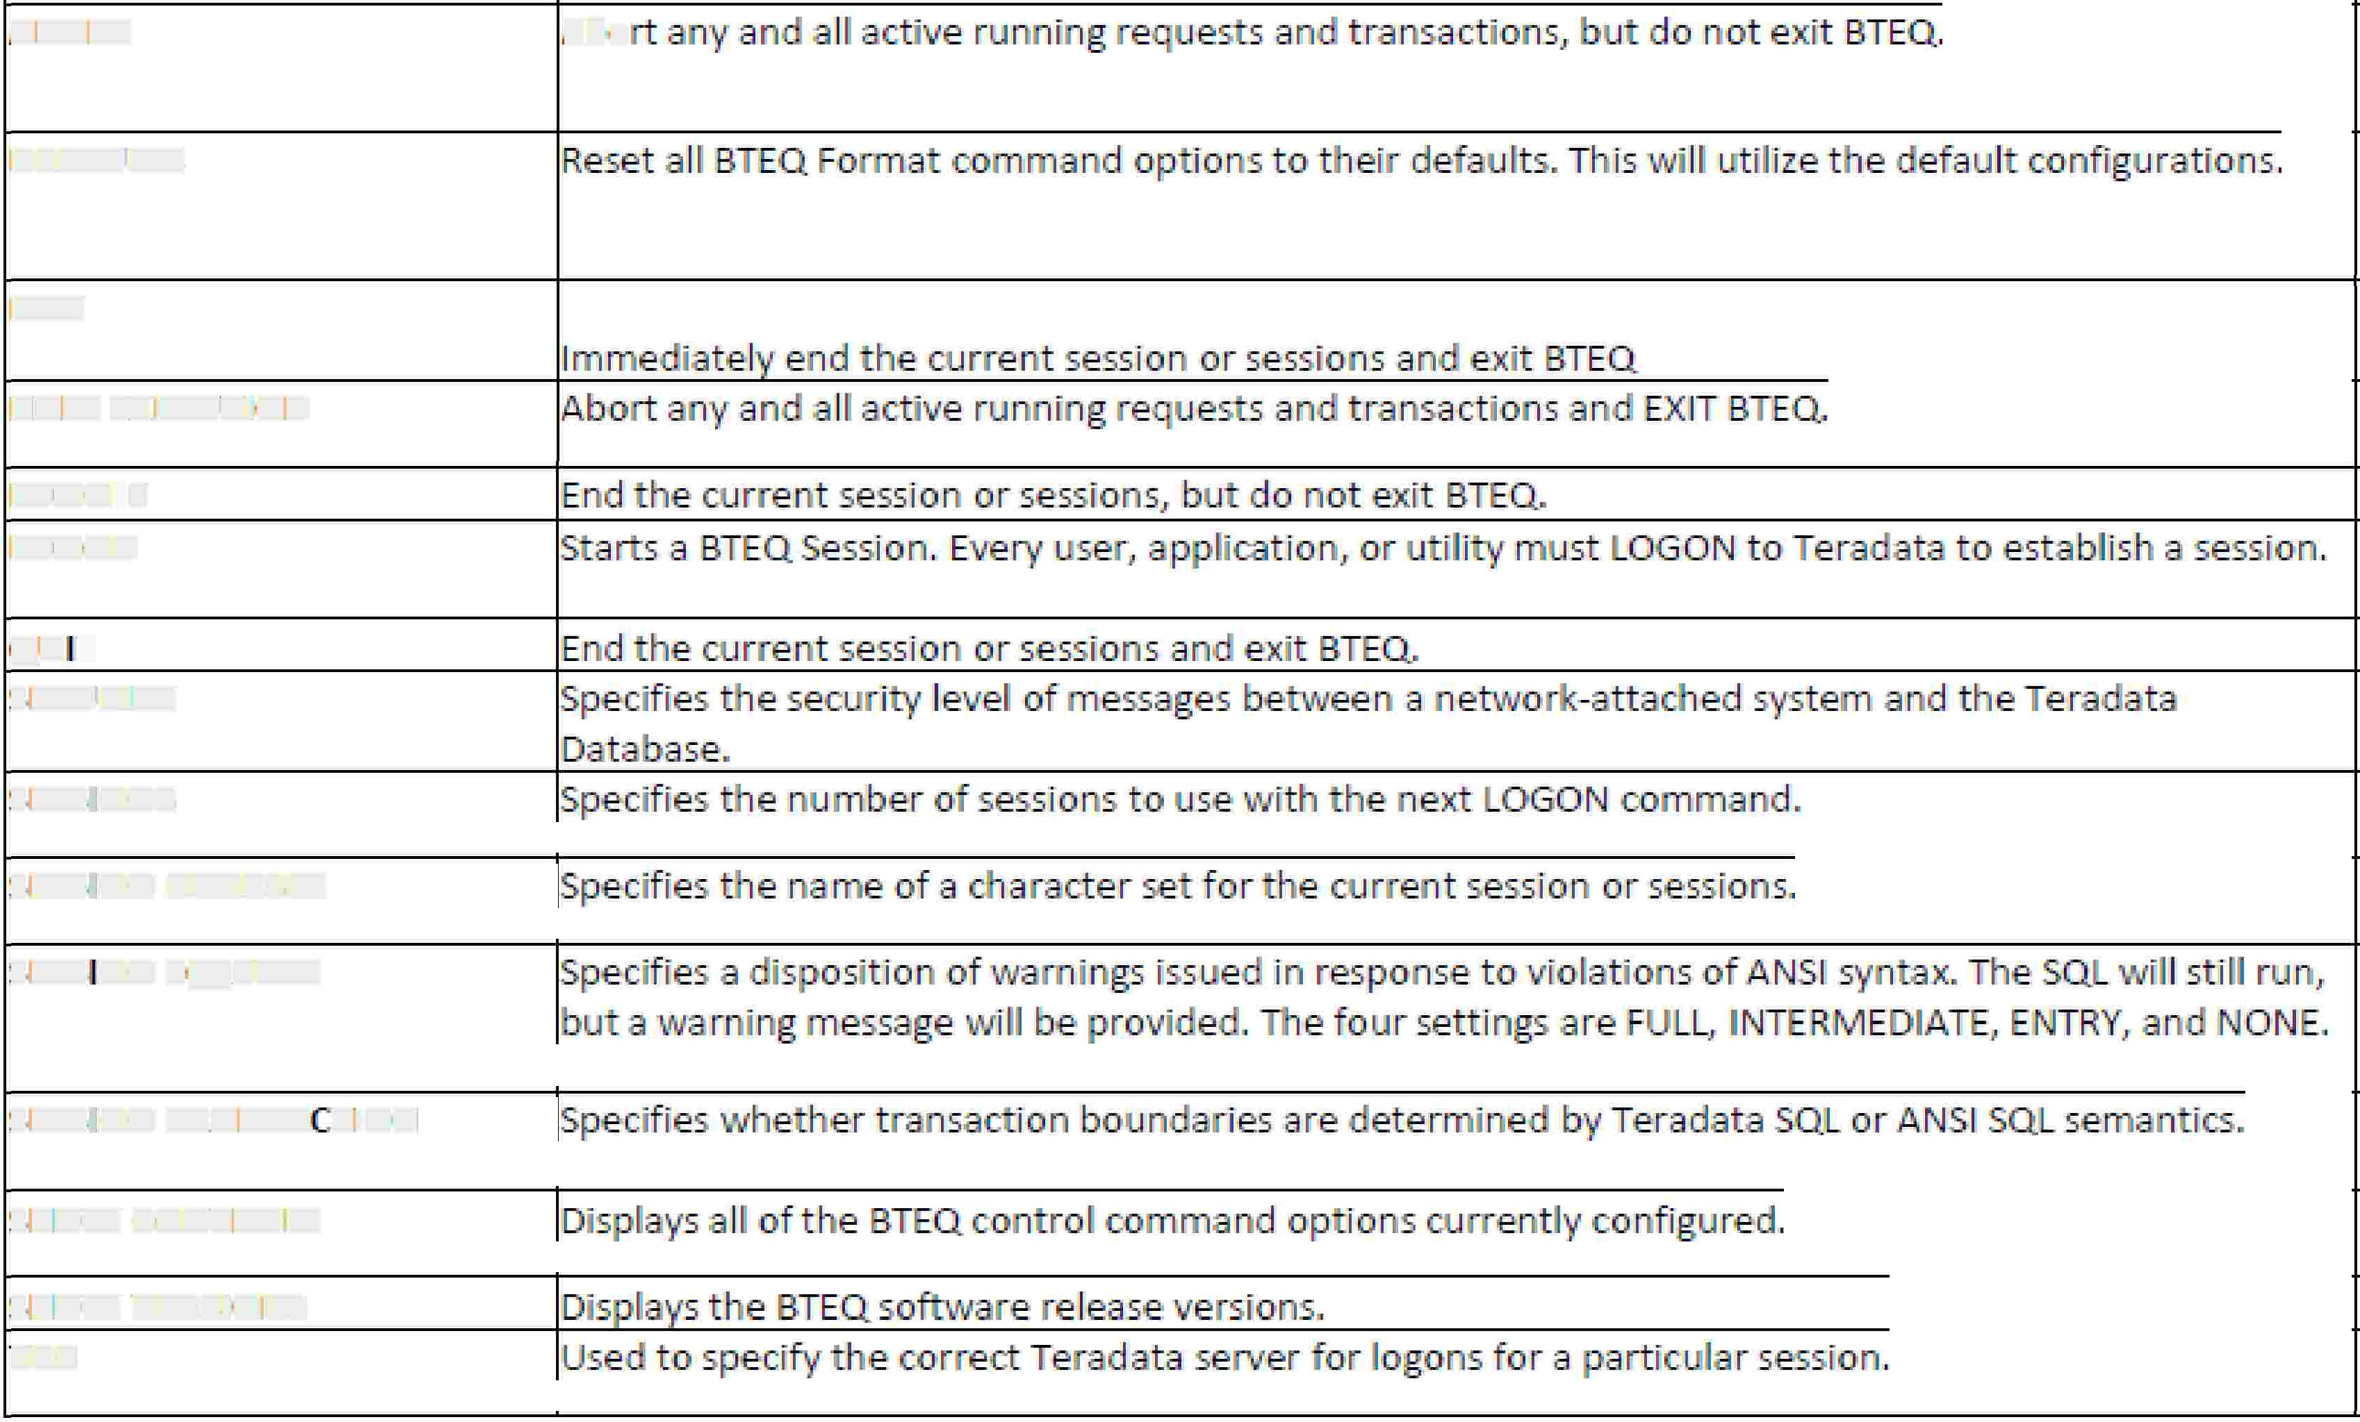

BTEQ
Commands
Session Centro Command
ABORT
Abo
DEFAULTS
EXJJ
HALT EX ECUllilON
LOGO Ff
LOGON
QUIT
SEUIRIT\f
SESSIIONS,
he next
OGO N comm d.
S ESSIION CHARSH
SESSION SQLIIFLA'6
S ESSIION TRANSA ·. lilON
SHOW GONliROLS
SHOW VERSIONS
liDP'
Capgemmi
CON 5 ULT I NG. TECH NOL O G Y. 0 UT 5 0 UR CI NG
Presentation Title | Date
Copyright © Capgemini 2015. All Rights Reserved 21

Slide 22
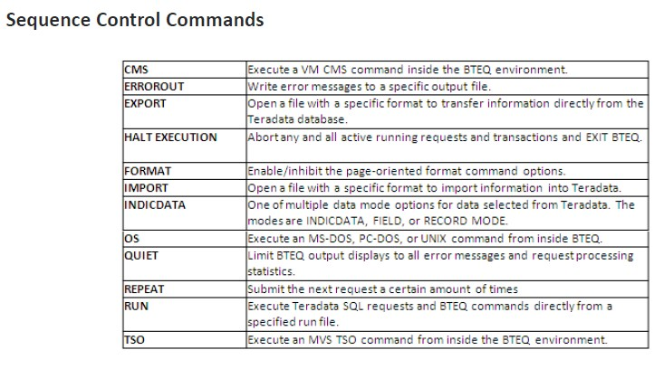
BTEQ
Commands
Presentation Title | Date
Copyright © Capgemini 2015. All Rights Reserved 22

Slide 23
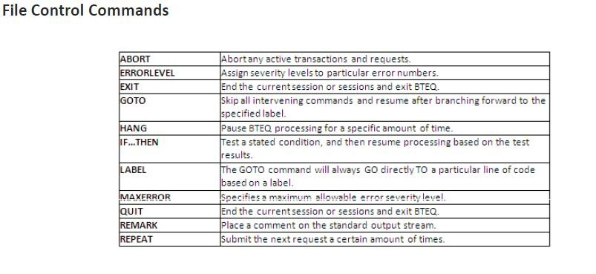
BTEQ
Commands
Presentation Title | Date
Copyright © Capgemini 2015. All Rights Reserved 23

Slide 24
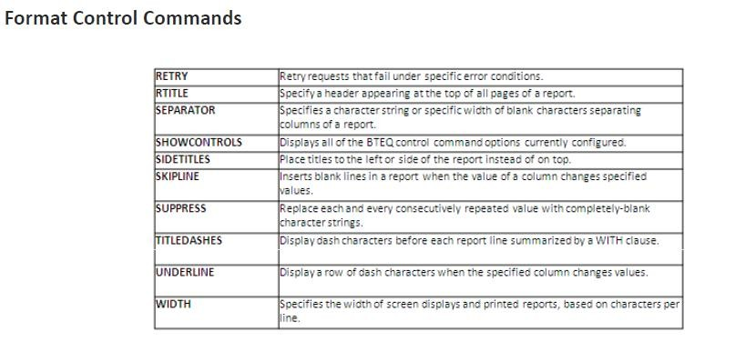
BTEQ
Commands
Presentation Title | Date
Copyright © Capgemini 2015. All Rights Reserved 24

Slide 25
Q
&
A
Presentation Title | Date
Copyright © Capgemini 2015. All Rights Reserved 25

Slide 26
QUIZ
▪
▪
▪
▪
▪
1. Which application interface is used by BTEQ?
A. ODBC
B. JDBC
C. CLIv2
D. OLE DB
Option C
▪
Which two functionalities are available through the BTEQ tool?
(Choose two.)
A. supports ad hoc queries
B. is checkpointrestartable
C. runs scripted batch queries
D. provides high volume data export
▪
▪
▪
▪
Option A,C
Presentation Title | Date
Copyright © Capgemini 2015. All Rights Reserved 26

Slide 27
BTEQ: LAB Exercise
Problem BTEQ_1 :
In this lab, you will use BTEQ to perform imports with different numbers of sessions. You will move
selected rows from a data file to the OLAP_EXAMPLE_CLASS table using different
sessions.
numbers
of
What you need
OLAP_EXAMPLE_CLASS table and a data file.
Tasks
1. Export all the rows to a data file (data2_1) from OLAP_EXAMPLE_CLASS table.
2. Delete all rows from your OLAP_EXAMPLE_CLASS table.
3. Import the rows from your data set (data2_1) to the empty OLAP_EXAMPLE_CLASS table. Note the time and verify the number of rows.
Time:
Number of rows:
4. Delete all the rows from your “userid.OLAP_EXAMPLE_CLASS_DMY” table again. (Continue with
the next slide…)
Presentation Title | Date
Copyright © Capgemini 2015. All Rights Reserved 27

Slide 28
BTEQ: LAB Exercise
5. Specify 8 sessions and import the rows from your data set to the
OLAP_EXAMPLE_CLASS table. Note the time and verify the number of rows.
Time:
Number of rows:
6. Delete all the rows from OLAP_EXAMPLE_CLASS table again.
7. Specify 50 sessions and import the rows from your data set to
OLAP_EXAMPLE_CLASS table. Note the timing and verify the number of rows.
Time:
Number of rows:
8. What are your conclusions based on the tasks you have just performed?
Presentation Title | Date
Copyright © Capgemini 2015. All Rights Reserved 28

Slide 29
Contact
information
Insert contact picture
Name
Last Name Title/Role name.lastname@capgemini.com
Insert contact picture
Name
Last Name Title/Role name.lastname@capgemini.com
Capgemini Office (Optional)
Address Line 1
Address Line 2
Address Line 3
Capgemini Office (Optional)
Address Line 1
Address Line 2
Address Line 3
Insert contact picture
Name
Last Name Title/Role name.lastname@capgemini.com
Insert contact picture
Name
Last Name Title/Role name.lastname@capgemini.com
Capgemini Office (Optional)
Address Line 1
Address Line 2
Address Line 3
Capgemini Office (Optional)
Address Line 1
Address Line 2
Address Line 3
Presentation Title | Date
Copyright © Capgemini 2015. All Rights Reserved 29

Slide 30




About Capgemini
With almost 145,000 people in over 40 countries, Capgemini is one of the world's foremost providers of consulting, technology and outsourcing services. The Group reported 2014 global revenues of EUR 10.573 billion.
Together with its clients, Capgemini creates and delivers business and technology solutions that fit their needs and drive the results they want. A deeply multicultural organization, Capgemini has developed its own way of working, the Collaborative Business Ex perienc e™ , and draws on Rightshore®,
its worldwide delivery model.
Learn more about us at www.capgemini.com.
www.capgemini.com
The information contained in this presentation is proprietary.
Copyright © 2015 Capgemini. All rights reserved. Rightshore® is a trademark belonging to Capgemini.

